Slide 1
DIFFERENTIAL AMPLIFIERS
MULTİSTAGE AMPLIFIERS (Cascade Amplifier Circuits

Slide 2
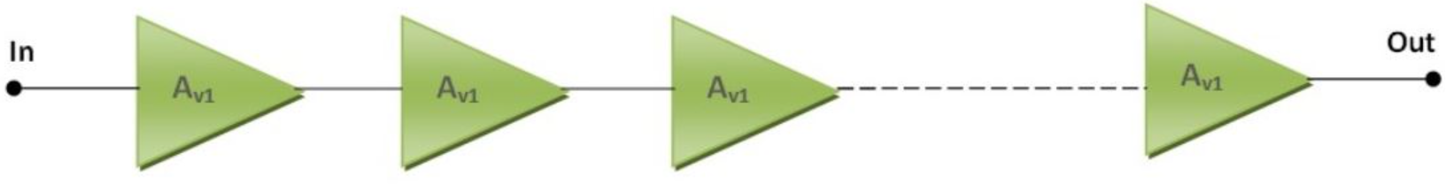

Cascade Amplifier Circuits
Each triangle symbol represents a separate amplifier.

Slide 3
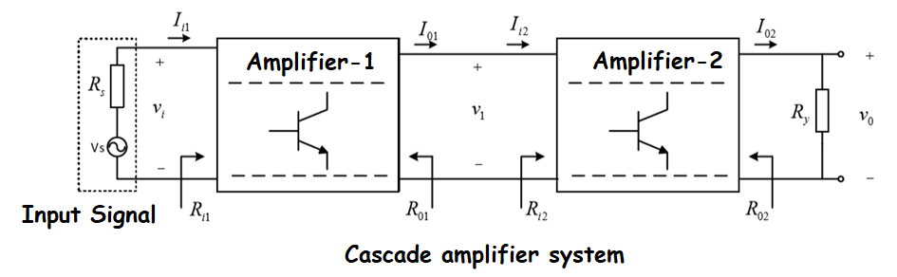
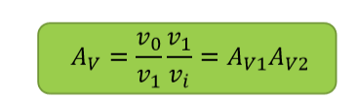
Cascade Amplifier Circuits
The structure obtained when the amplifiers are connected one after the other is called cascade amplifier.
The output terminals of the amplifier used in this structure are connected to the input terminals of the next stage.
It should be noted here that the output resistance of Amplifier-1 does not consist only of R01.
When calculating the gain of the amplifier, the input resistance Ri2 of the Amplifier-2 should also be taken into account.

Slide 4
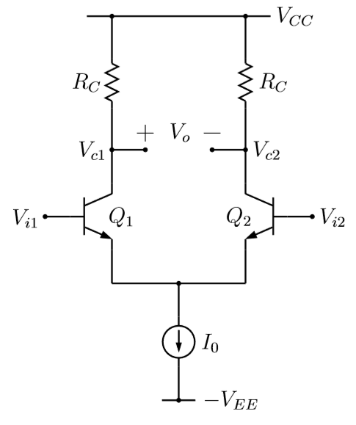
DIFFERENTIAL AMPLIFIERS
The tail supply is modeled as a current source IQ. The object is to solve for the small-signal output voltages and output resistances. It will be assumed that the transistors are identical.

Slide 5
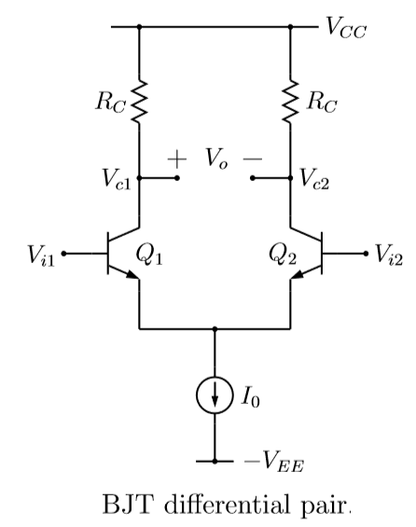

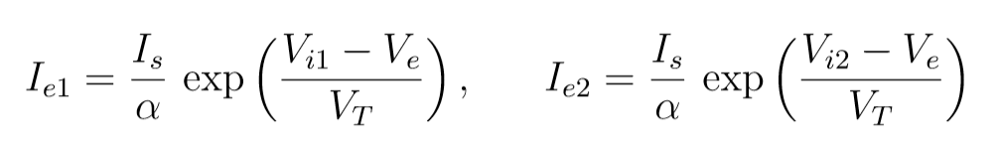
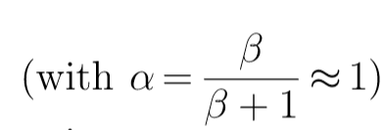

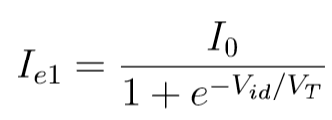
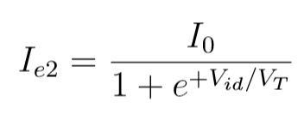
DIFFERENTIAL AMPLIFIERS
Large signal behaviour of the circuit
Differential input signal

Slide 6
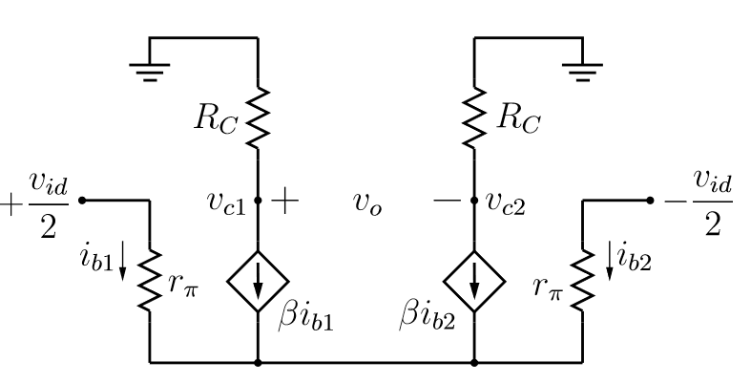
Small signal behaviour of the circuit

Slide 7
Let us ﬁnd the diﬀerential- and common-mode
gains for this ampliﬁer.

Slide 8
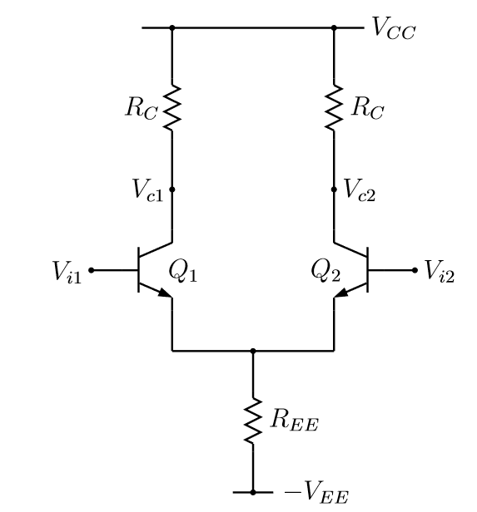


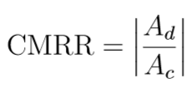
The output of the diﬀerential ampliﬁer is given by:
Differential mode gain
Common mode gain
A good diﬀerential ampliﬁer should reject Vic entirely, i.e., it should have Ac =0.
In reality, ‘Ac’ for a diﬀerential ampliﬁer is small but ﬁnite, and a ﬁgure of merit called the “Common-Mode Rejection Ratio” (CMRR) is used to indicate the eﬀectiveness of the ampliﬁer in rejecting common-mode inputs. The CMRR is deﬁned as :

Slide 9
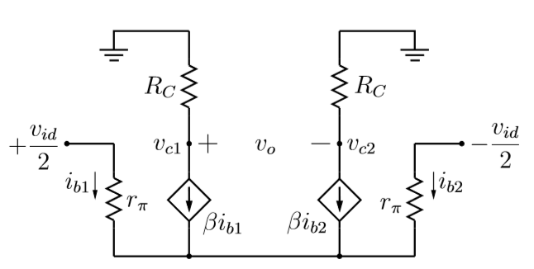



2
1

Slide 10
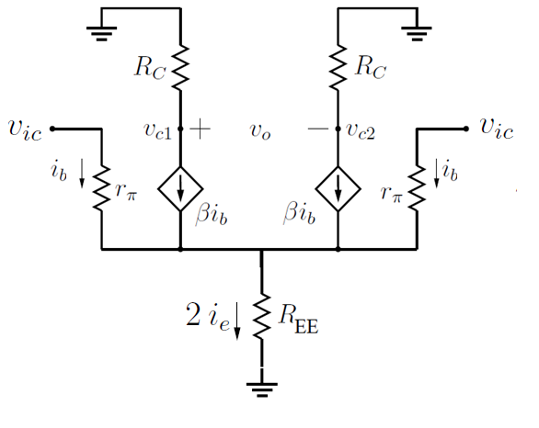
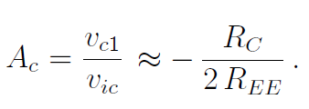
To ﬁnd the common-mode gain, we apply a small signal vi1 =vi2 =vic

Slide 11
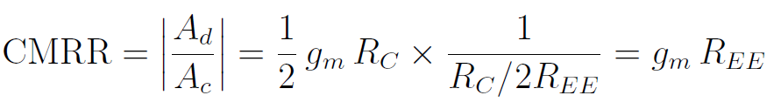

Slide 12

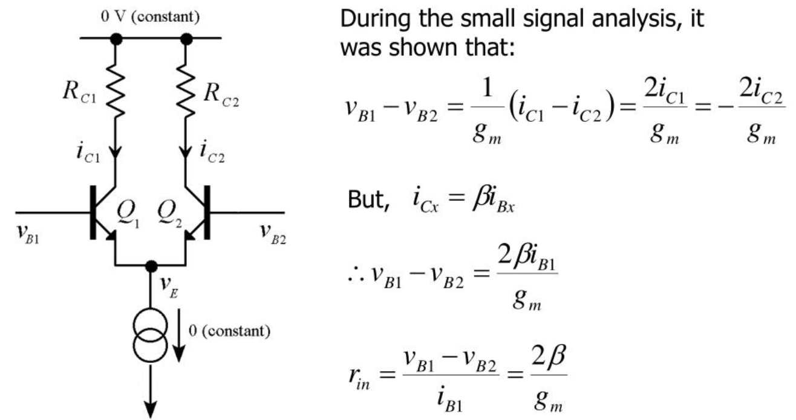

Slide 13

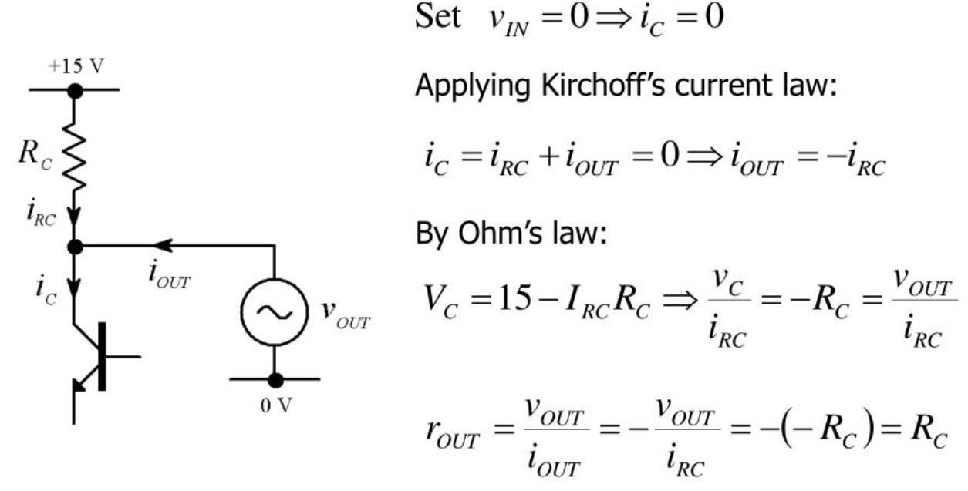

Slide 14
Multistage Transistor Amplifiers

Slide 15
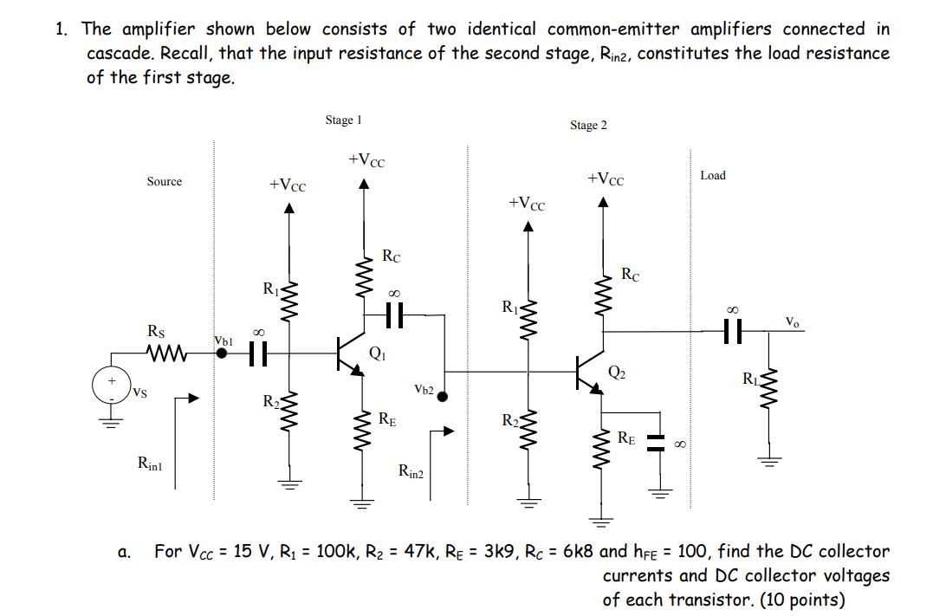

Slide 16
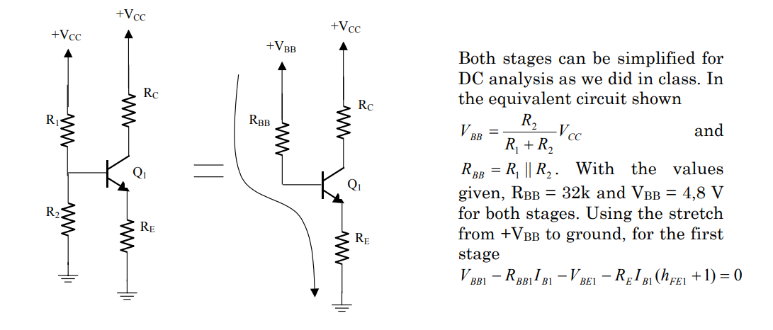

Slide 17
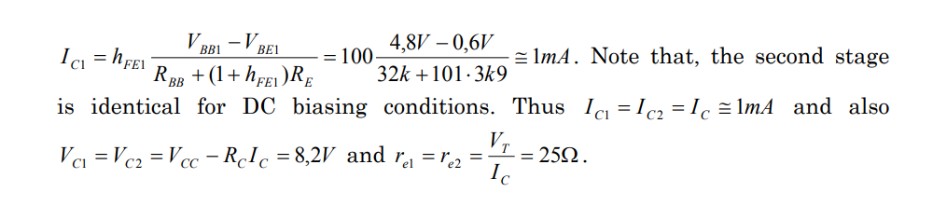

Slide 18
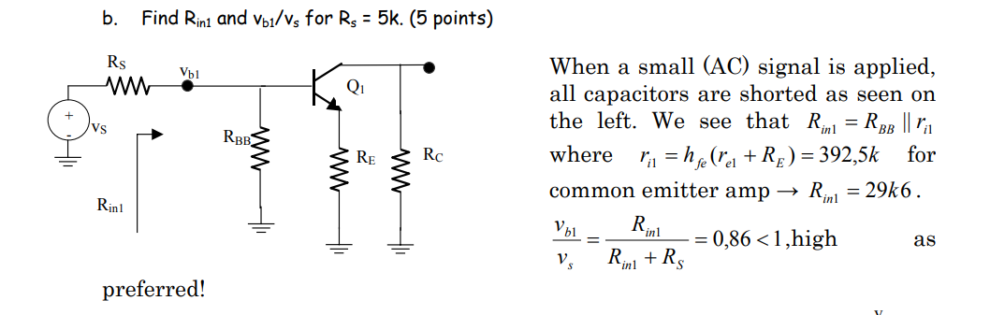

Slide 19
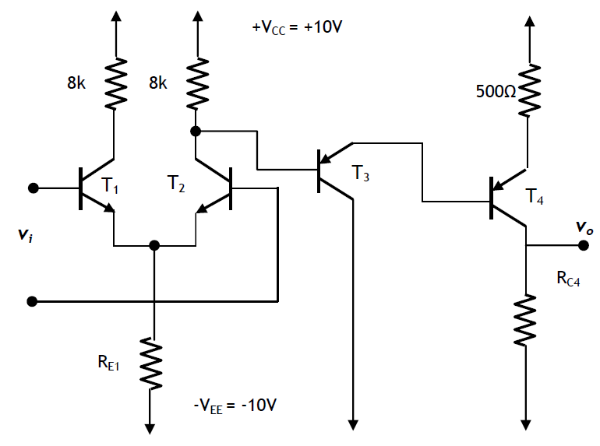
EXAMPLE

Slide 20
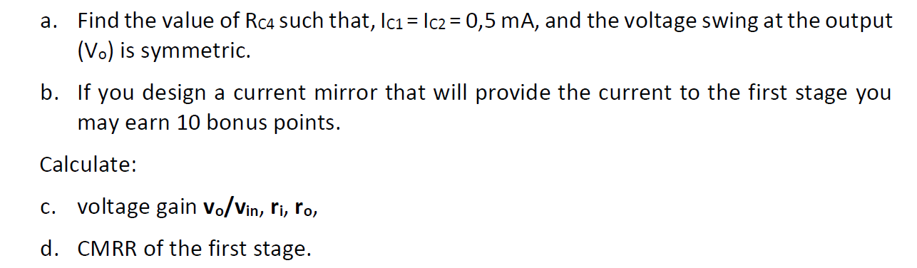

Slide 21
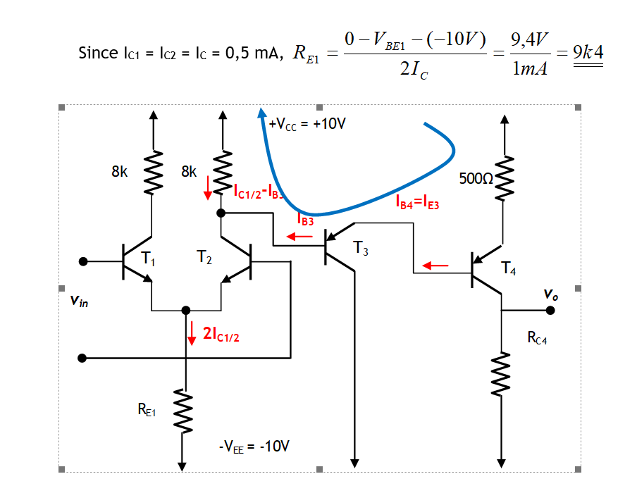

Slide 22
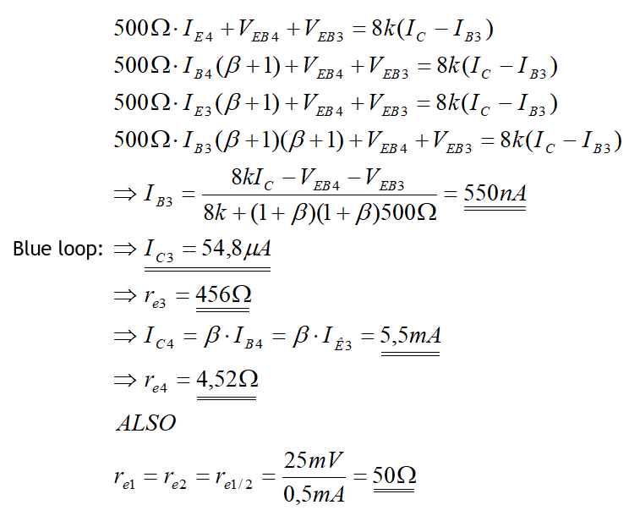

Slide 23
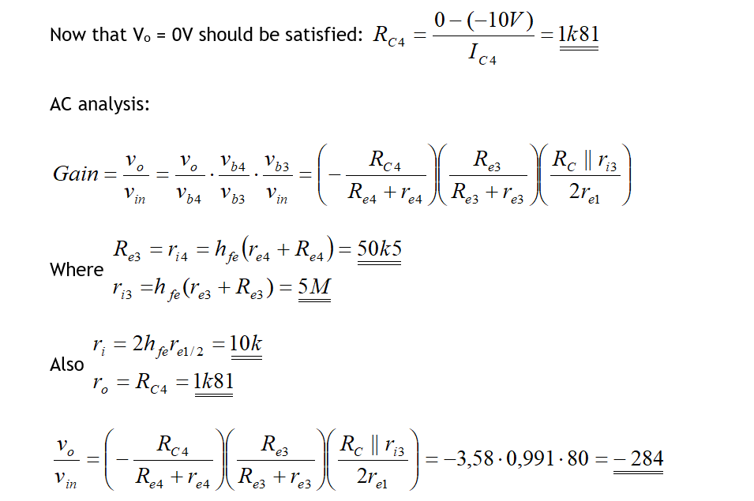

Slide 24
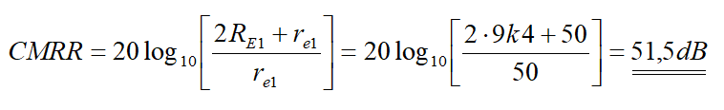

Slide 25
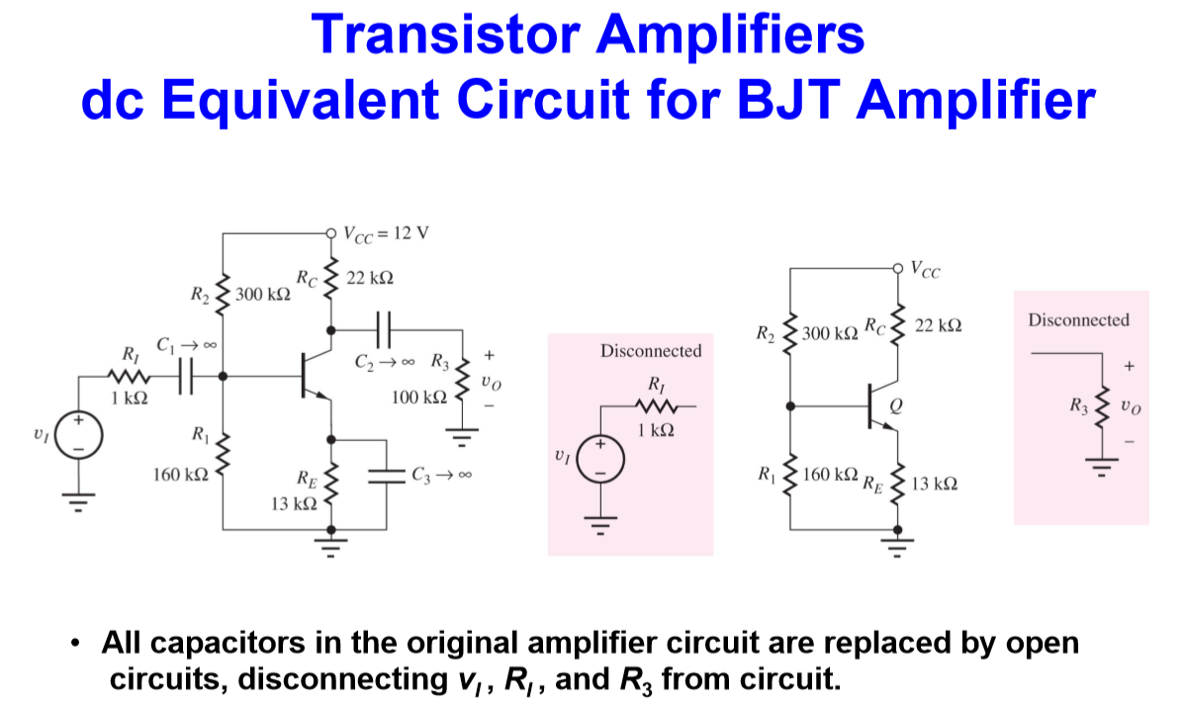

Slide 26
Coupling and By-pass Capacitor:
The capacitor is an element that insulates the DC signal but passes AC signal.
In an electronic circuit, when a capacitor is used to take advantage of this feature, it is called a coupling (bağlama) capacitor.
There may be elements in the circuit that must remain in terms of the DC components, but must be disabled for AC signals. By connecting a capacitor in parallel, unwanted element can be disabled for AC signals. The capacitor used for this purpose is called bridge (by-pass) capacitor.

Slide 27
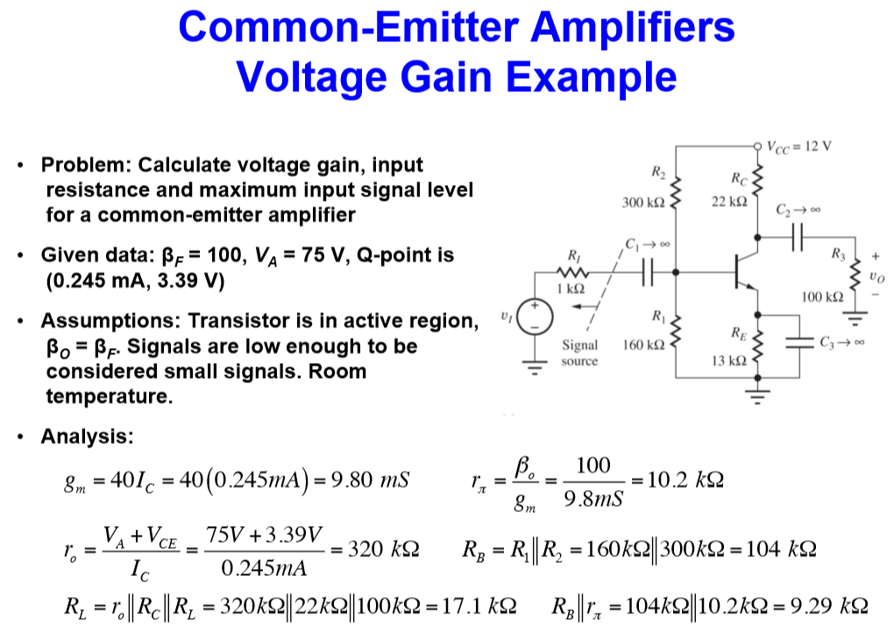

Slide 28
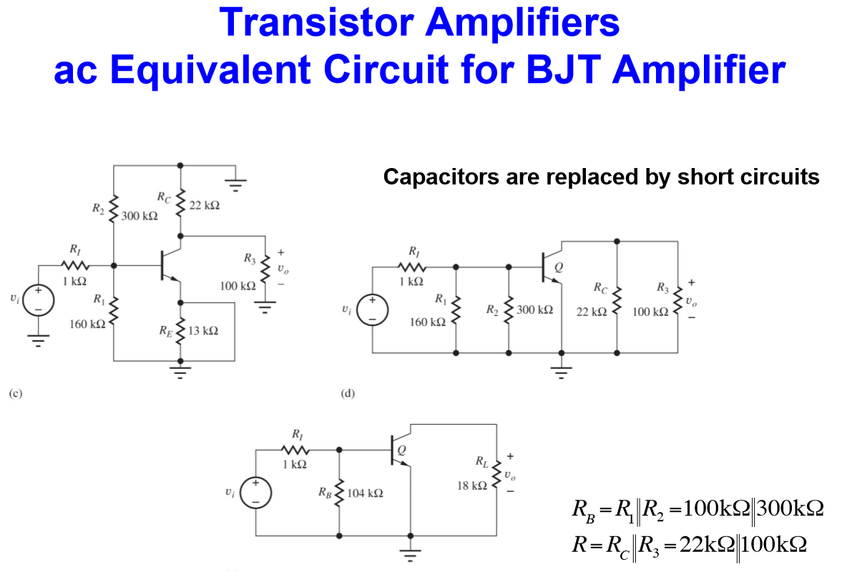

Slide 29
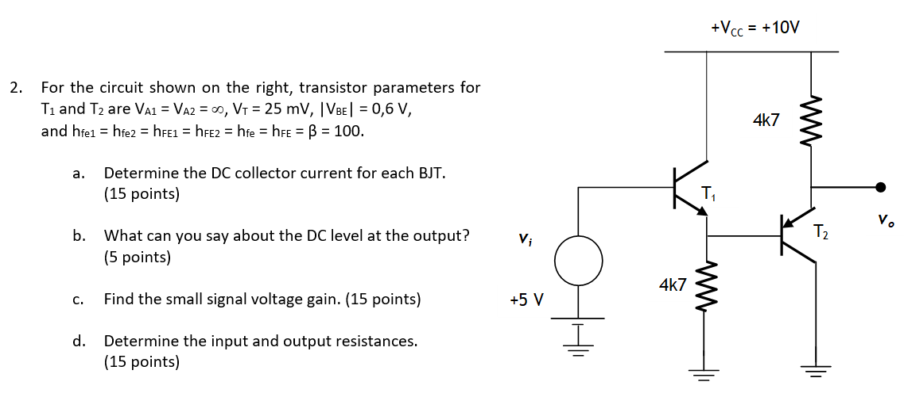
EXAMPLE

Slide 30
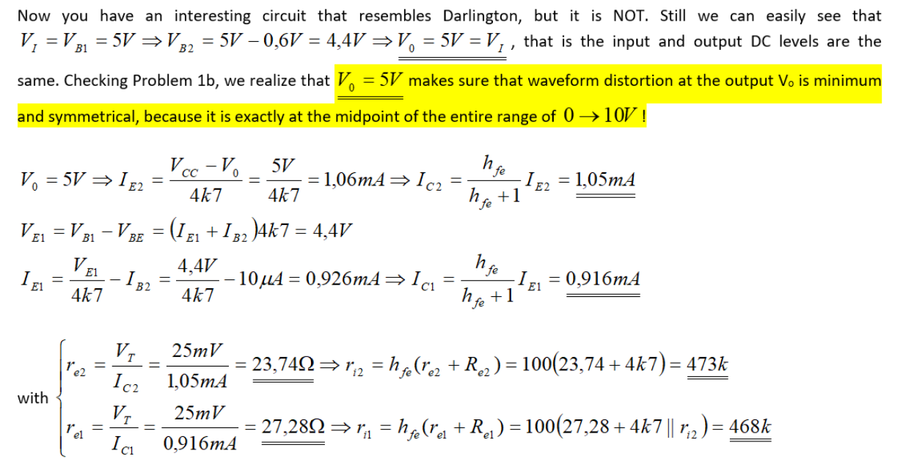

Slide 31
